Slide 1
Player and Ball and Tracking with Homography Estimations in Tennis and Cricket
By Vivek Jayaram, Maruchi Kim, Aaliyah Hänni
Notes:
Aaliyah
Hello, today our team is going to be talking about object detections in sports

Slide 2
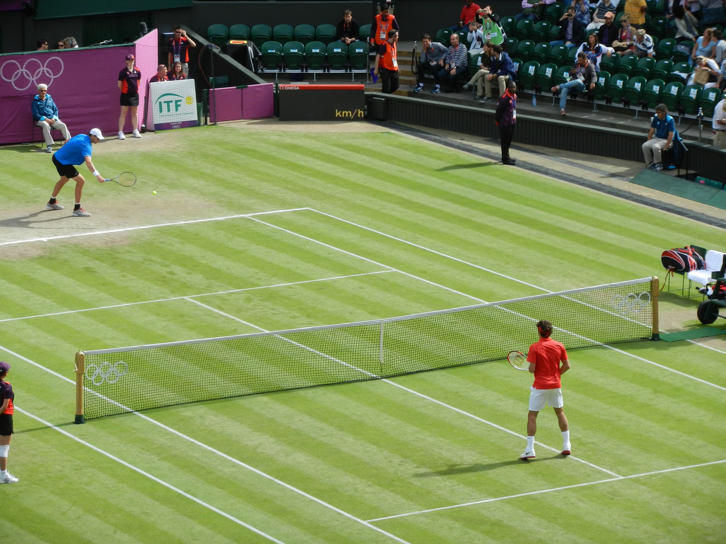
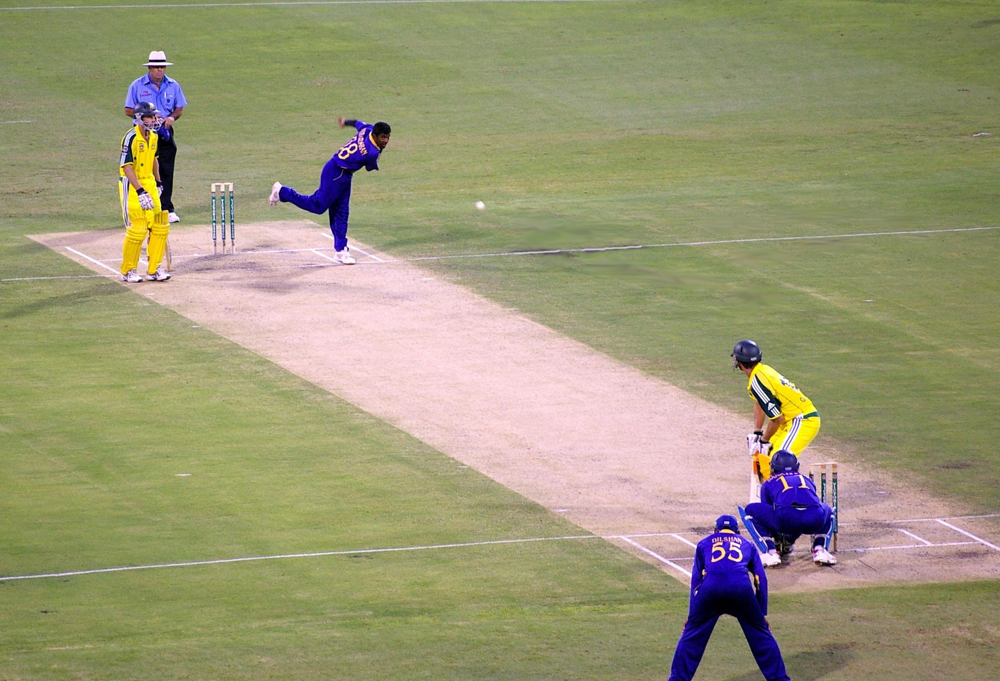
Sports Tracking Goals
Player Tracking
Tennis Ball Tracking
Cricket Ball Tracking
Notes:
Aaliyah
The goal of this project is to track players, as well as balls in the games of tennis and cricket

Slide 3
Motivation
Design a recommendation system to enhance tennis and cricket player performance
Reduce implementation costs of current methods
# of cameras required with current implementation
Resolution of videos
Improved inference
Accessibility devices
Provide live audio & trackable vibrations for those with disabilities
Notes:
Aaliyah
We have several motivations for this project including
>feeding our results into a recommendation system for players
>improve costs compared to current object detection methods used in sports
> use our output in accessibility devices that can provide audio and trackable vibrations for people with auditory or visual impairments

Slide 4
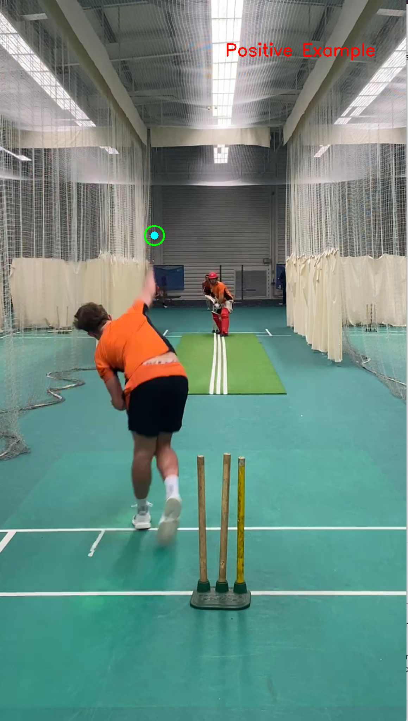
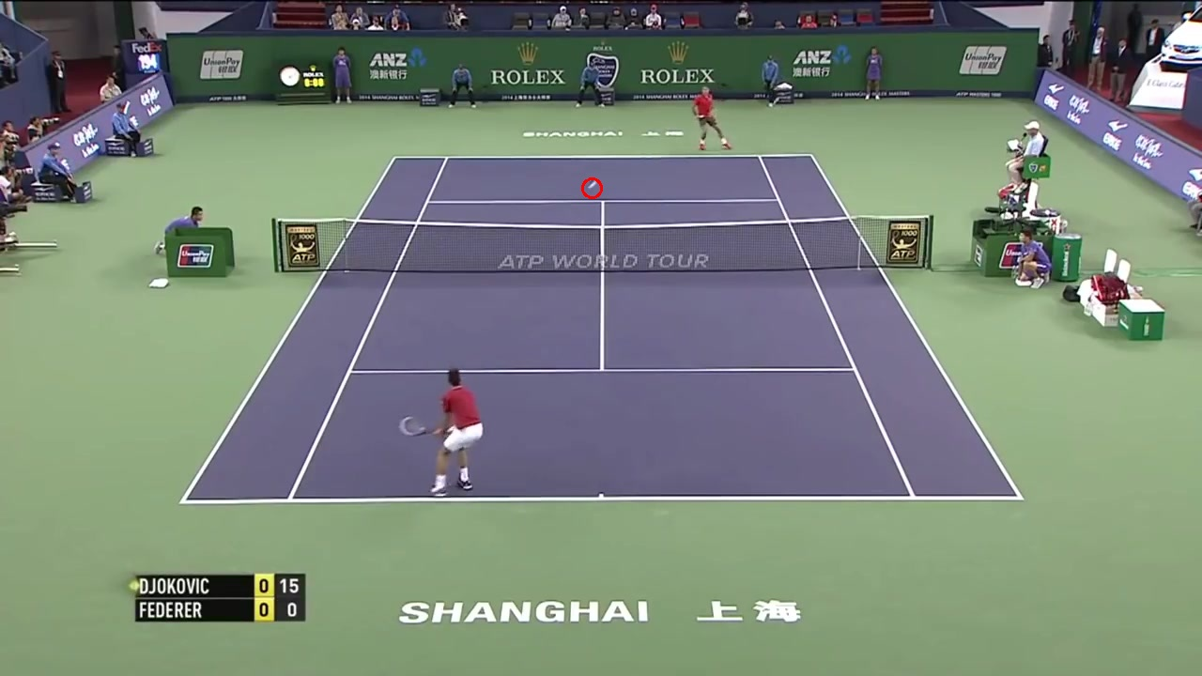
Datasets
Tennis Dataset
10 labeled complete tennis matches
Cricket Dataset
Several thousand ball annotated pitches
Notes:
Aaliyah
We use two large labeled datasets and comprehensive datasets, one for training our models on tennis and the other for cricket.

Slide 5
Player Tracking Overview
Detect objects (players) in images using YOLO
Grab bounding boxes of players (x_left + width/2), (y_top + height)
Between frames, grab players by finding next x,y with minimum coordinate change
Output JSON
Estimate homography onto a 2D aerial court with OpenCV, and project player coordinates onto 2D court
Using player and ball JSON objects, draw frame by frame onto output video
Notes:
Maruchi

Slide 6
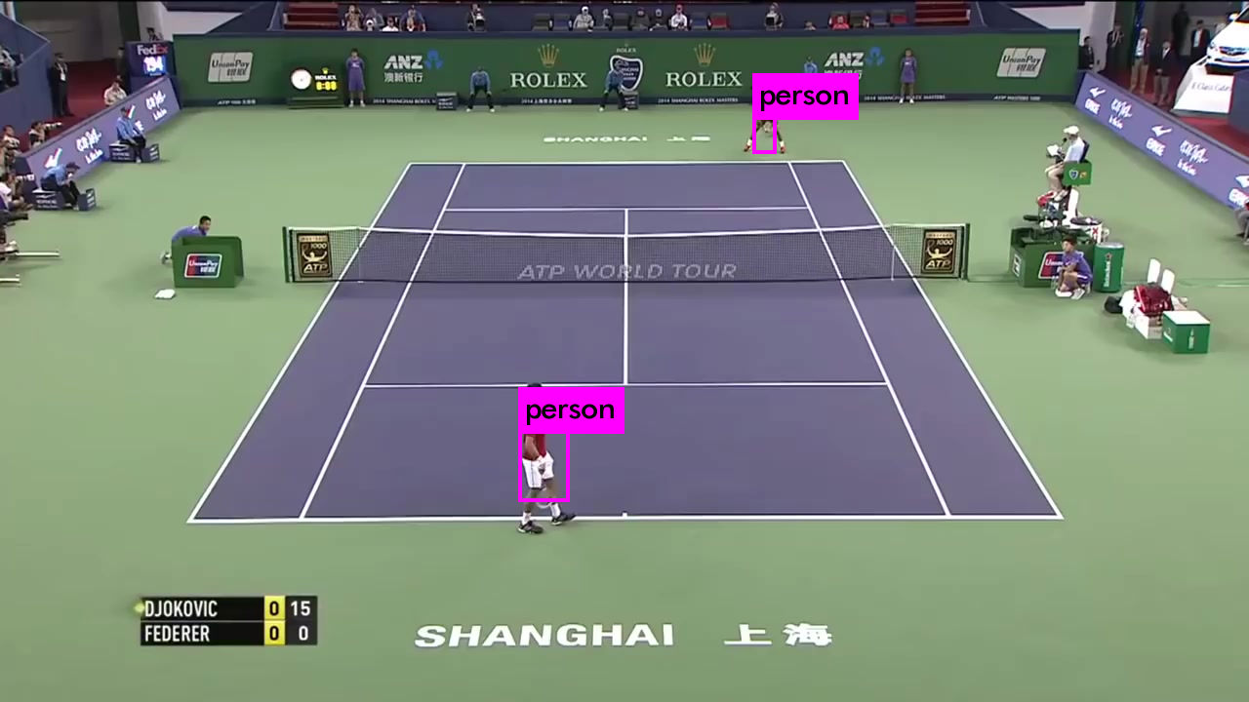
Player Tracking
Implementation Overview
Detect players using YOLO
Project bounding boxes onto 2D court using homography estimation
Output video of players and ball on 2D court
Notes:
Maruchi

Slide 7
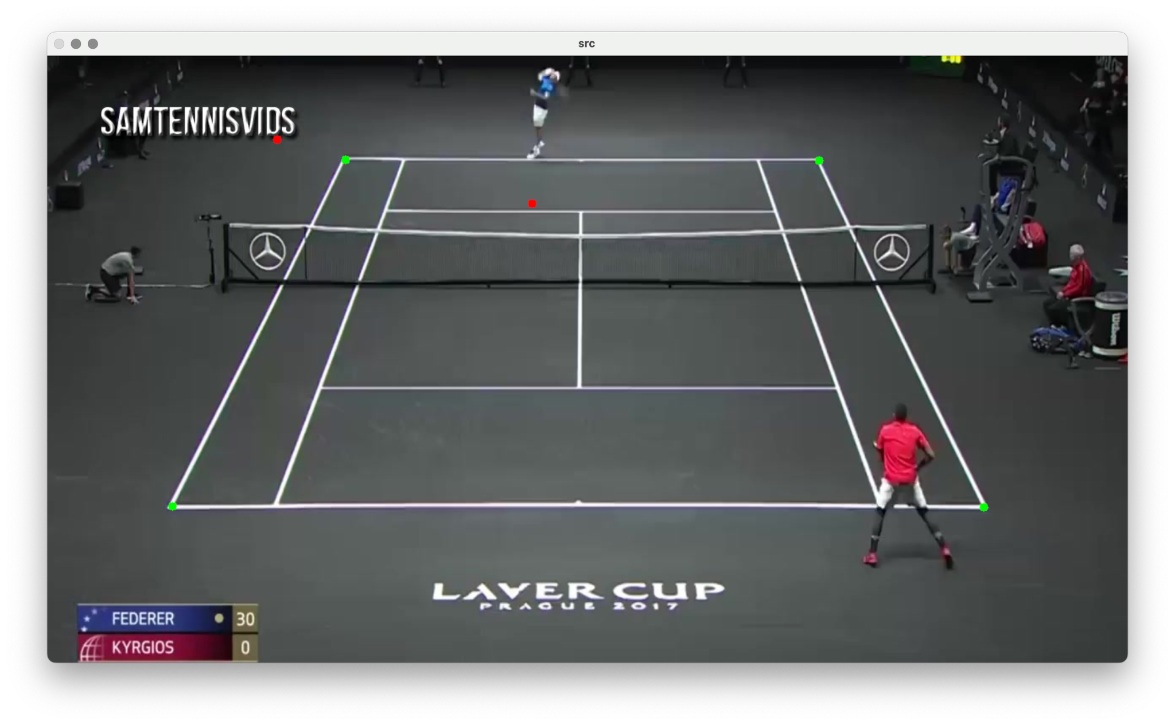
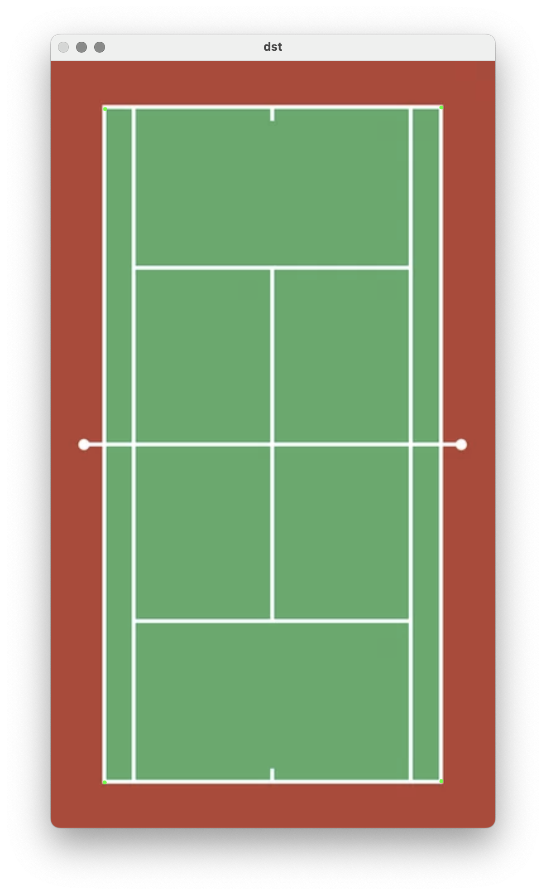
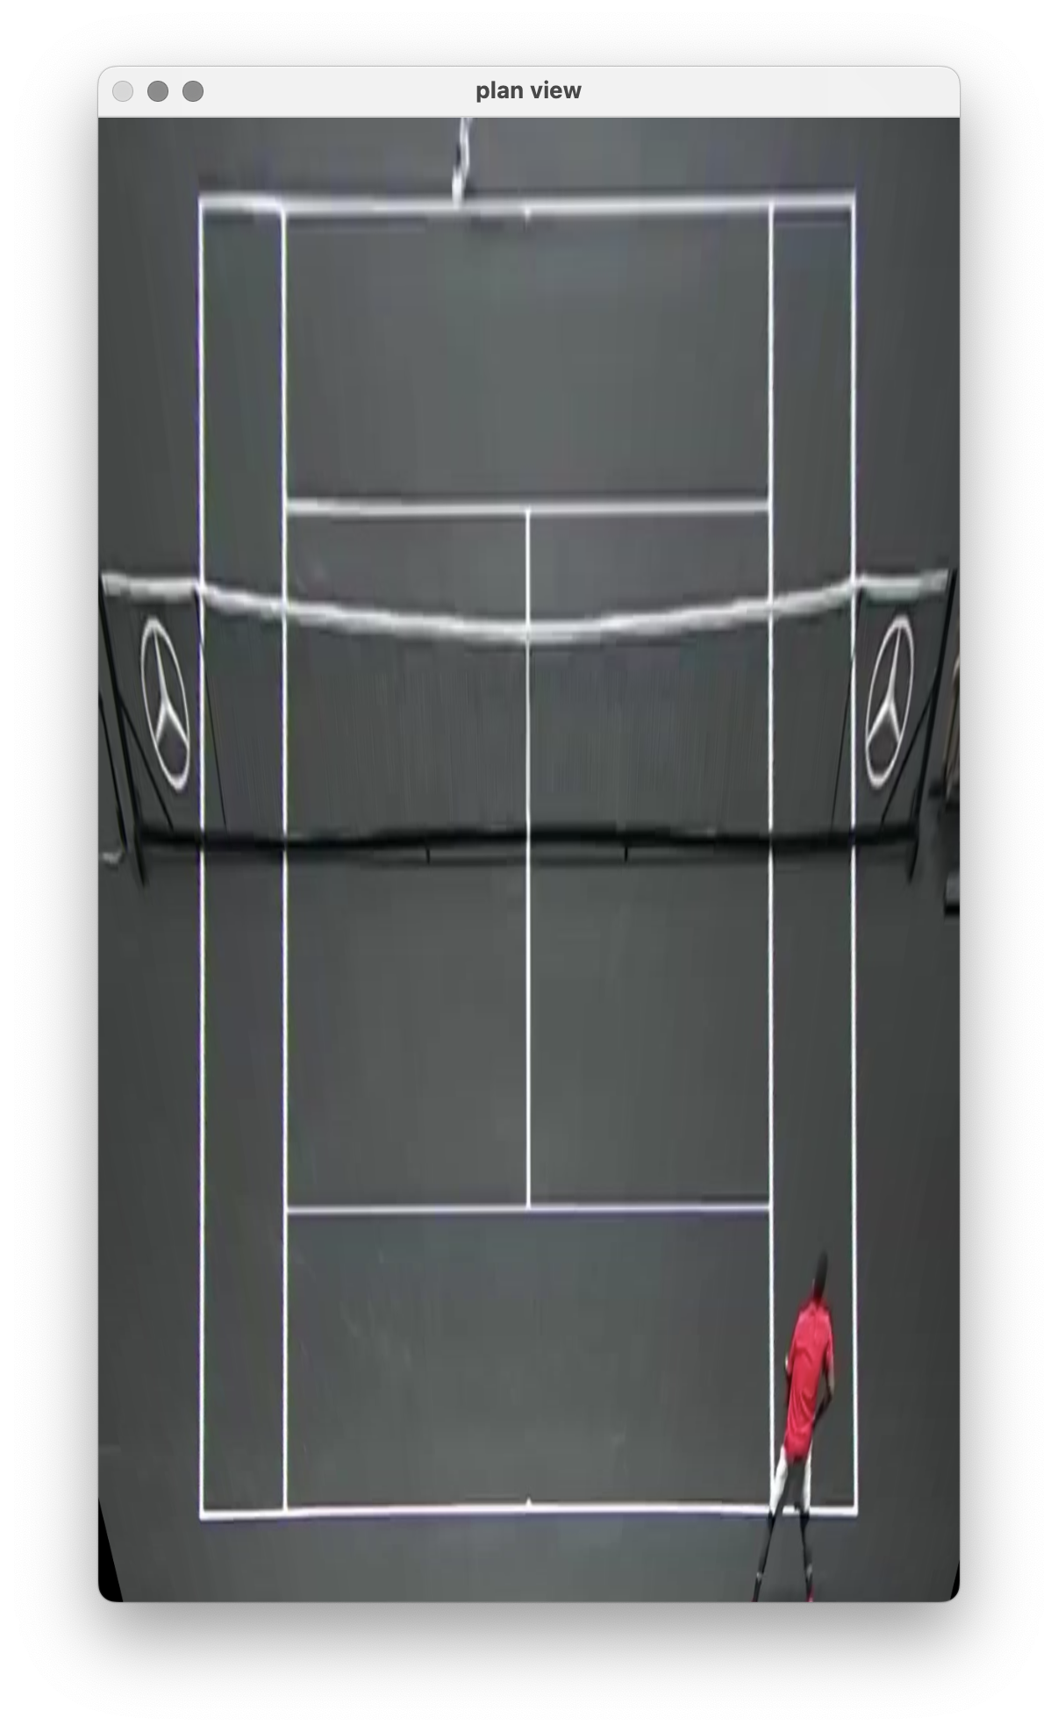
Homography Estimation
Implementation Overview
Detect players using YOLO
Project bounding boxes onto 2D court using homography estimation
Output video of players and ball on 2D court
Notes:
Maruchi

Slide 8
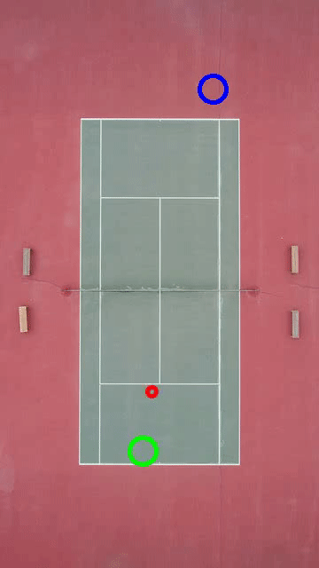
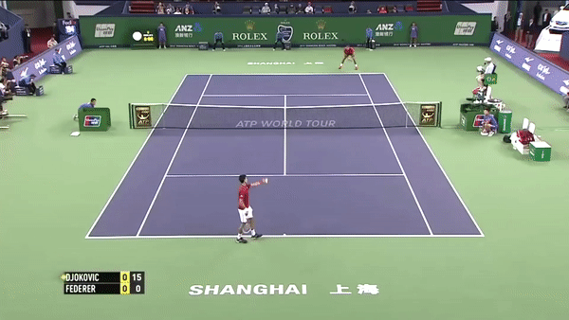
Video Output
Notes:
Maruchi

Slide 9
Notes:
Maruchi

Slide 10
Ball Tracking Overview
Detect tennis and crickets balls in images
UNet
Multi-Frame UNet
Perform Non-max Suppression to avoid nearby detections
Run a graph-based tracker to find continuous trajectory
Display example result videos
Notes:
Vivek

Slide 11
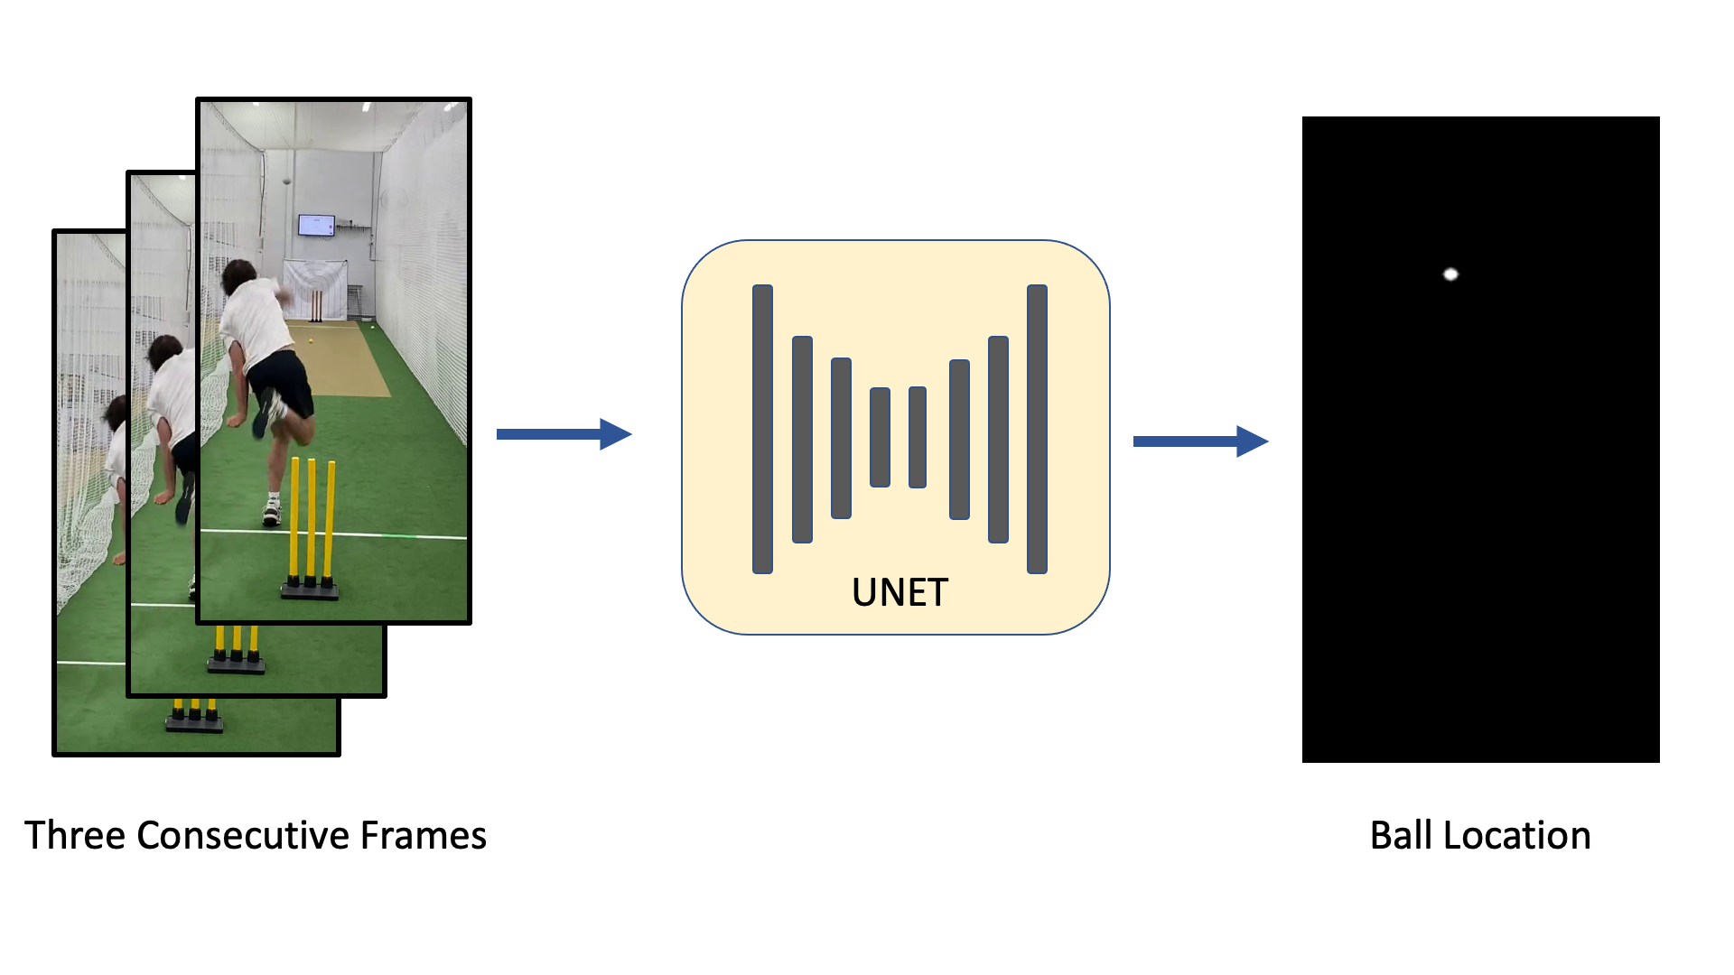
Multi-Frame UNet
Notes:
Vivek

Slide 12
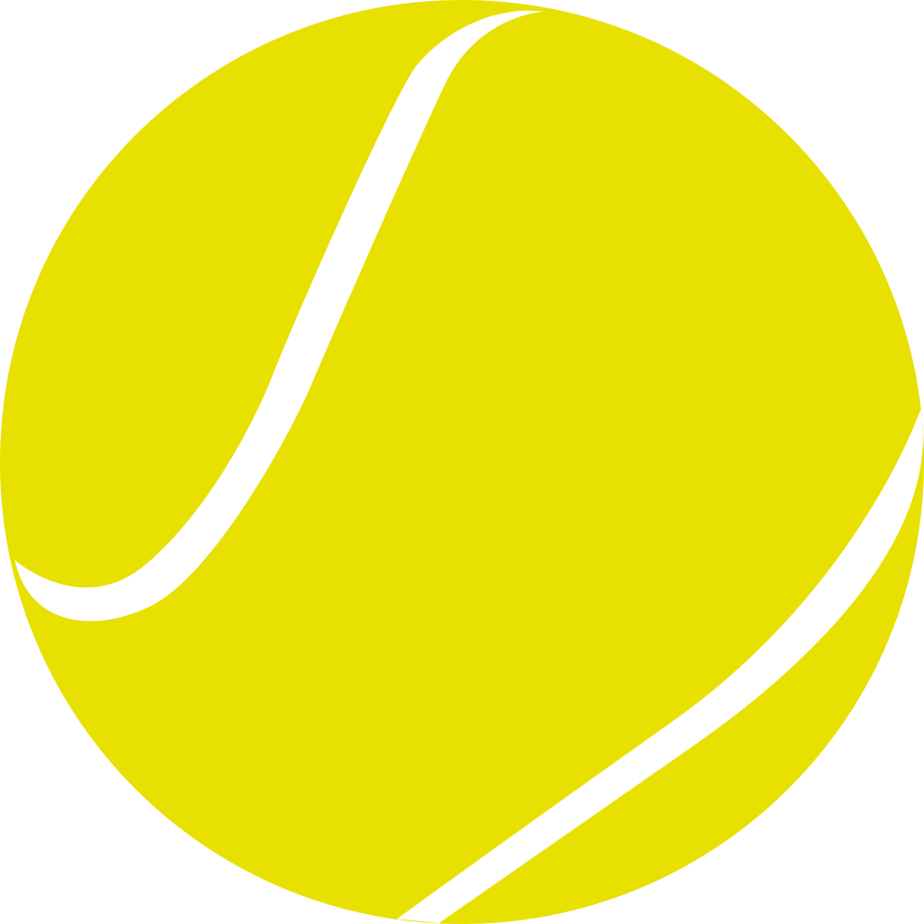
Tennis Ball Tracking
Model Task | Single Frame U-Net | Multi Frame U-Net
Precision | 25.2 | 42.4
Recall | 68.0 | 92.7
F1 | 36.8 | 58.2
Inference (ms) | 54.4 | 58.0
Notes:
Vivek

Slide 13
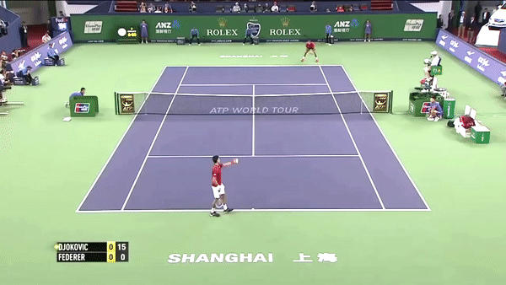
Result after Tracking
Notes:
Vivek

Slide 14
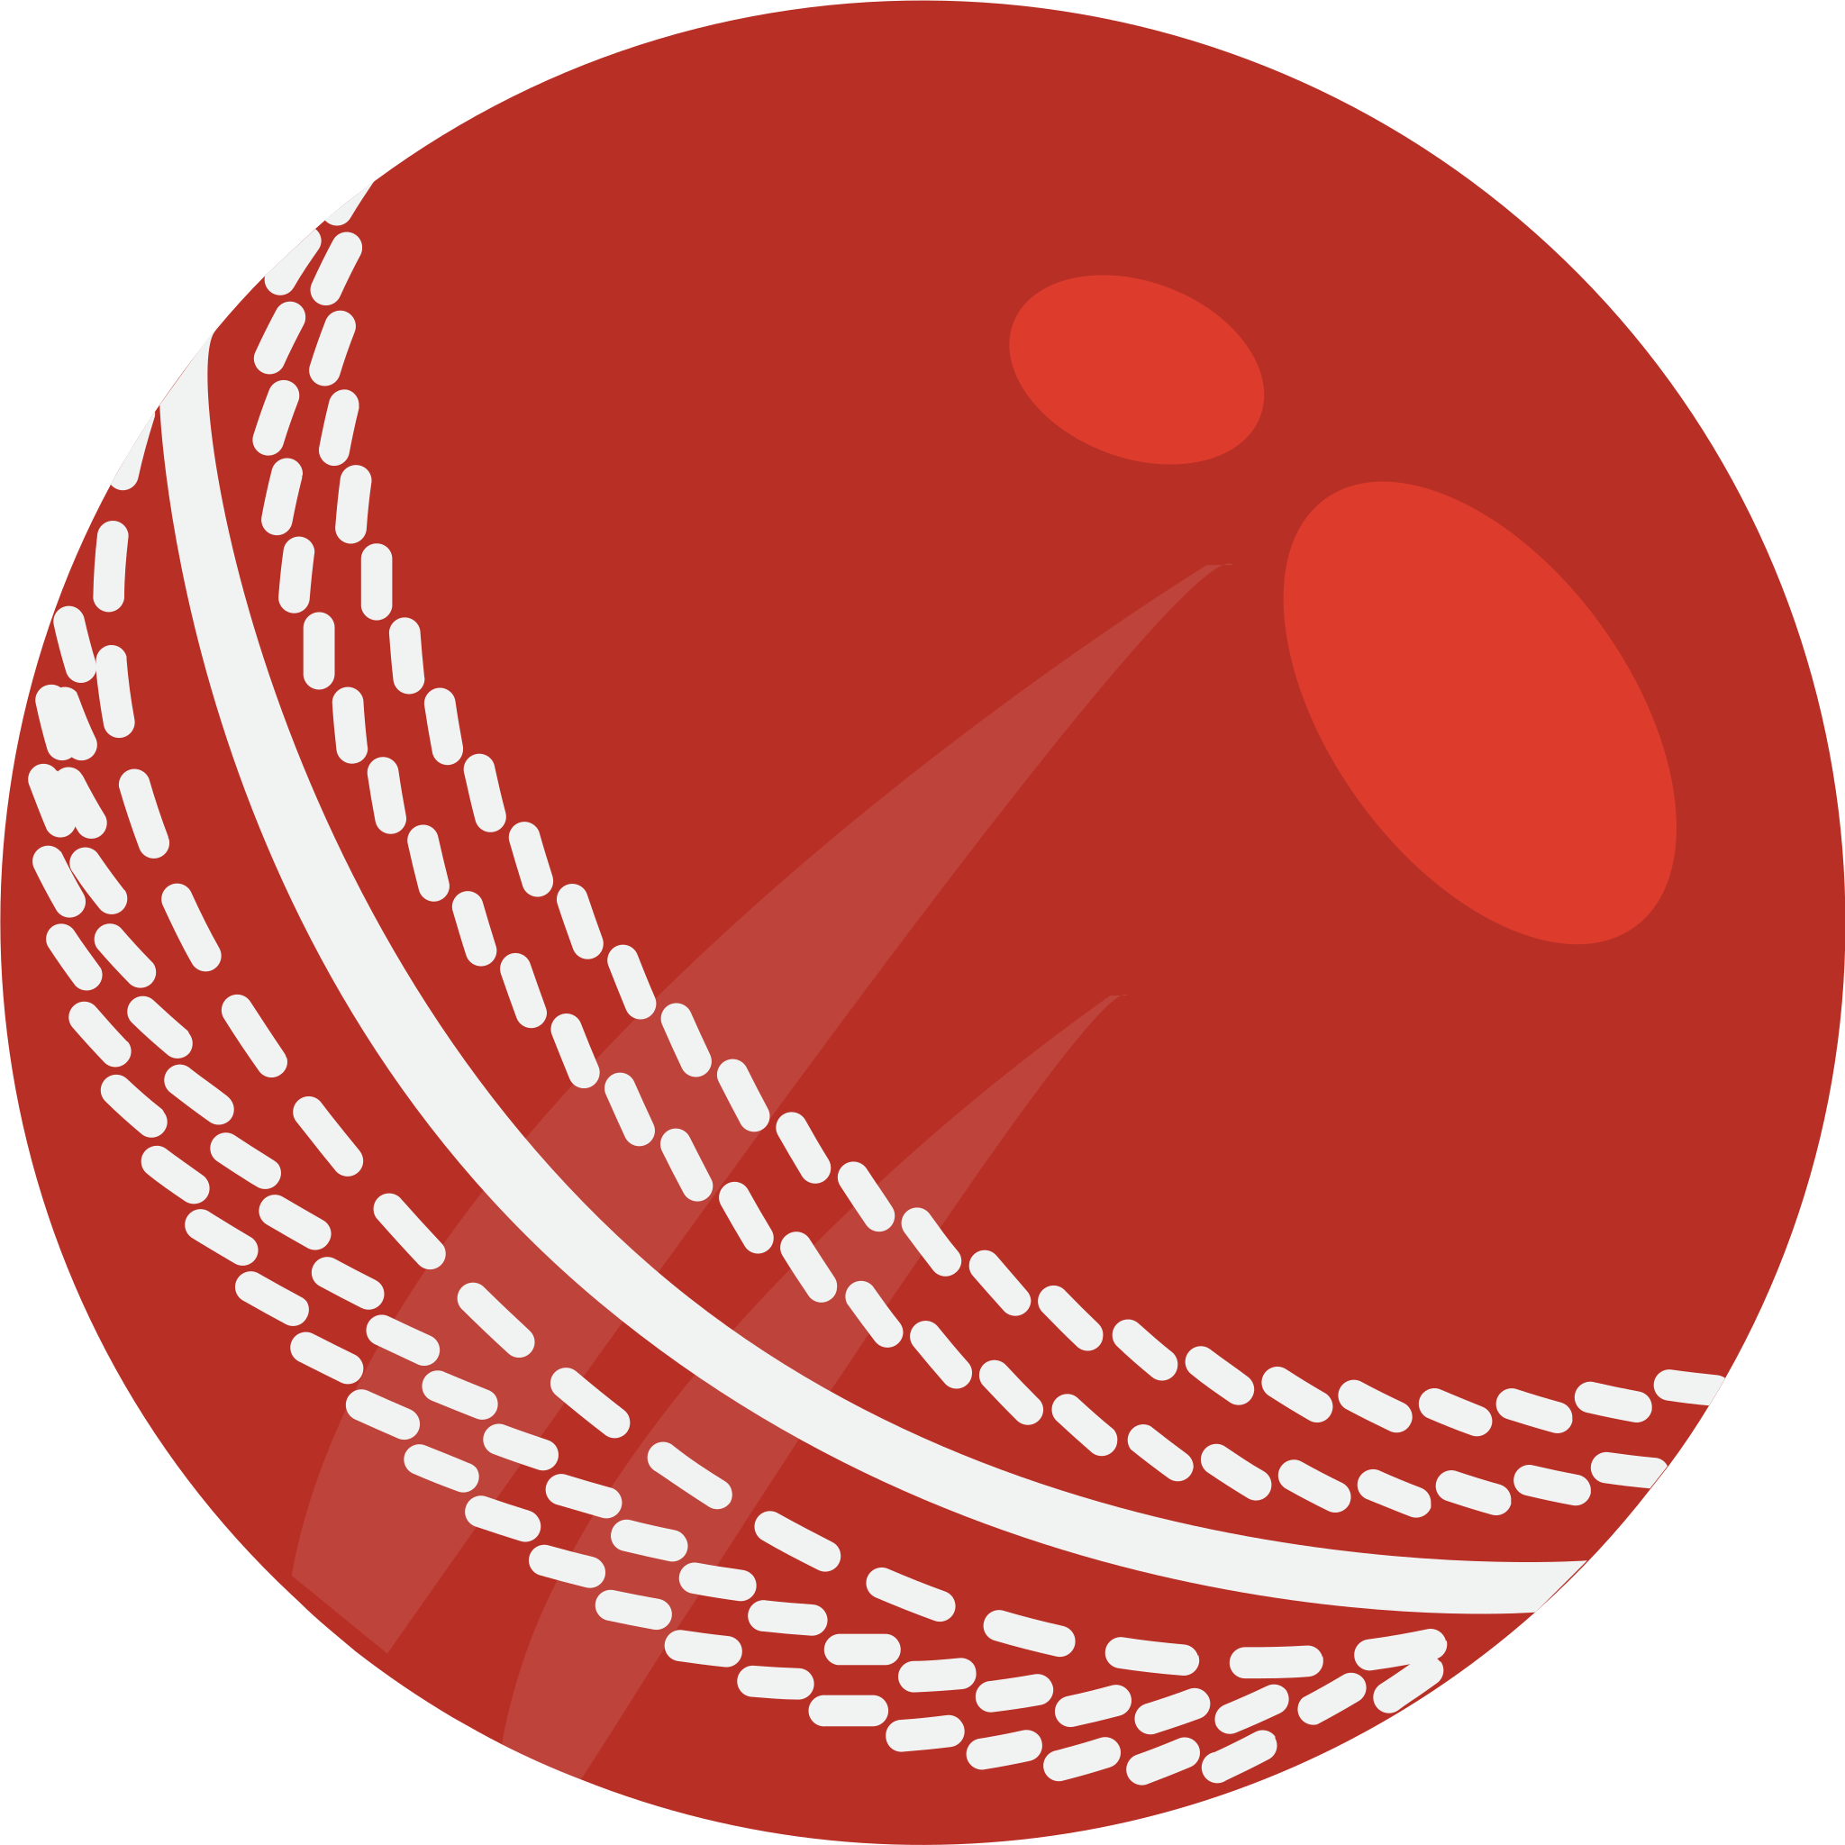
Cricket Ball Tracking
Model Task | Single Frame U-Net | Multi Frame U-Net
Precision | 55.2 | 92.1
Recall | 77.6 | 99.5
F1 | 64.5 | 95.7
Inference (ms) | 54.4 | 58.0
Notes:
Vivek

Slide 15
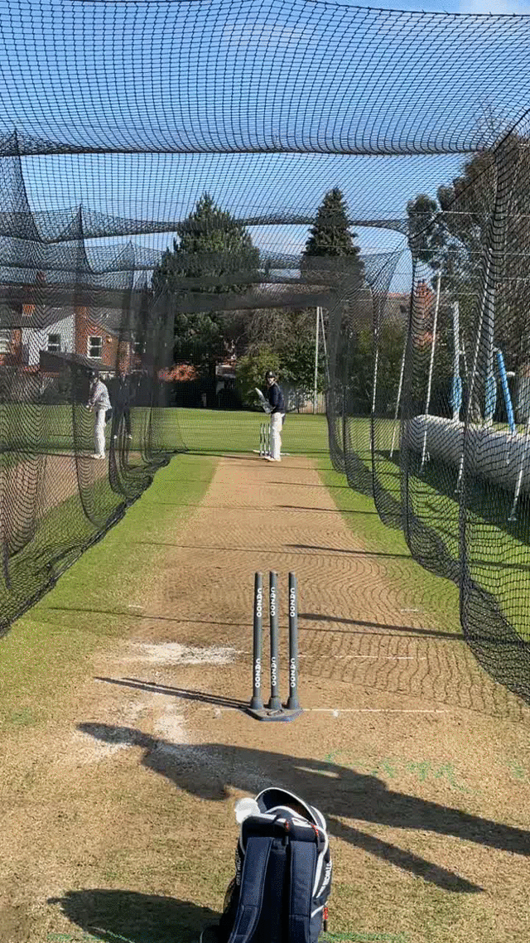
Detector Visualization
Notes:
Vivek

Slide 16
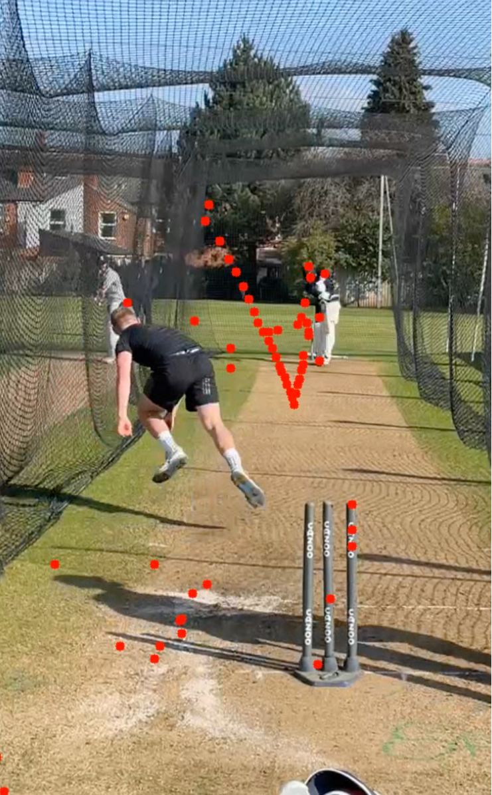
Detector Visualization
Notes:
Vivek

Slide 17
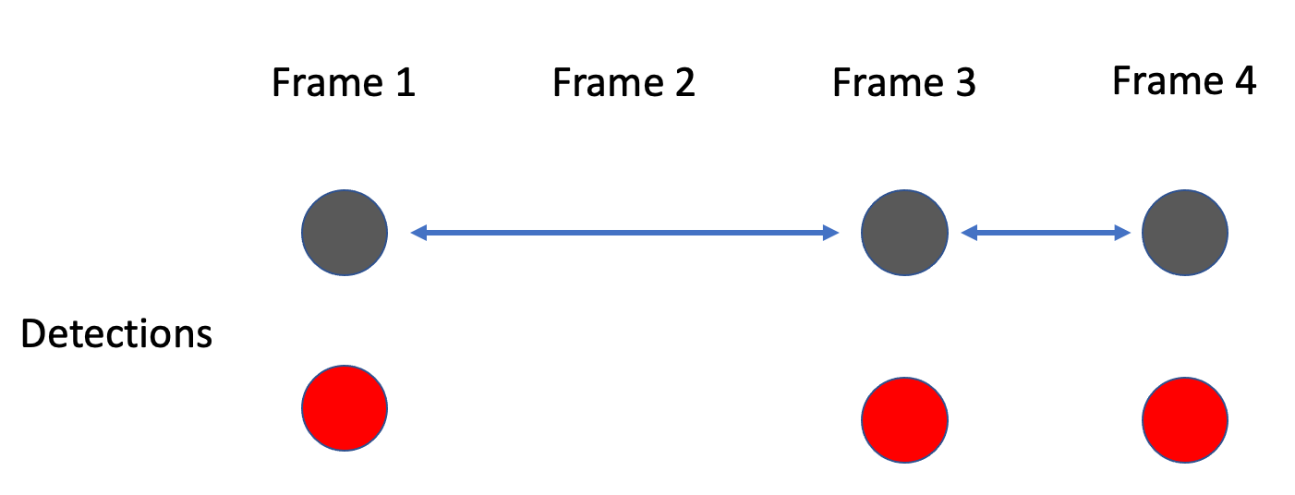
Tracking with Graphs and BFS
Find longest connected path in the graph
Notes:
Vivek

Slide 18
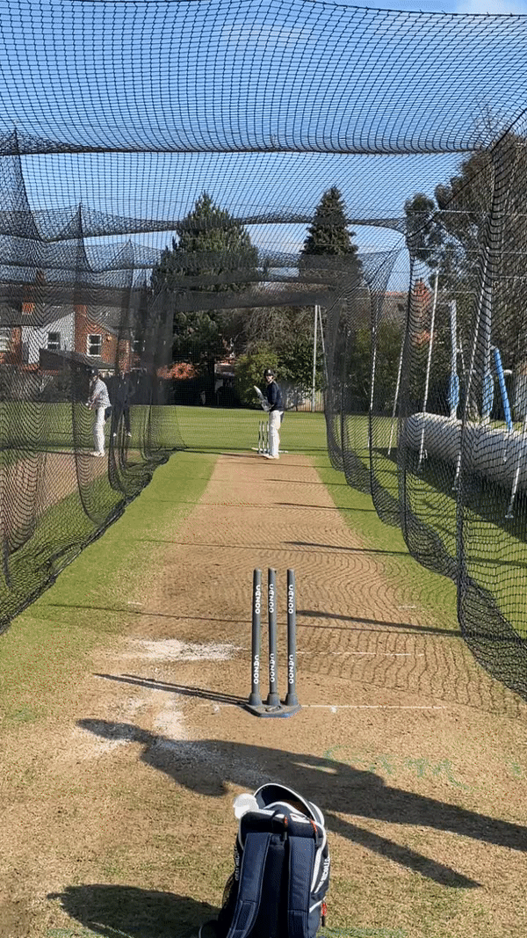
Result after Tracking
Notes:
Vivek

Slide 19
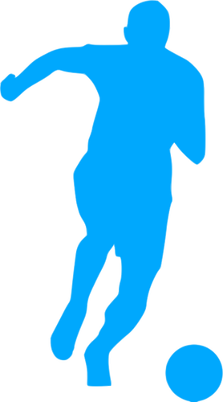
Potential Future Works
Action Detections
Ball bouncing, being hit, or in the air
Sports Recommendations
Compare player biometrics to professionals
Other Sports
Validate if techniques work for Soccer, Volleyball, or Hockey
Notes:
Aaliyah
Looking towards the future, we can further expand on our work in several ways such as
> detecting sports actions,
>apply our methodologies with other sports,
>and implement our initial motivation of using these results in developing sports recommendations.
Thank you

